Slide 1
Big Mountain Resort
Eric Kwon

Slide 2
Problem Identification
Question:
What increase in average priced is justified by data from other resorts as well as an additional chair with $1.54m operating costs?

Slide 3
Recommendation and Key Findings
Change the method of determining average price use:
Data Science and Analytics
Assess the performance and offerings of other resorts. Use EDA and Prediction modeling to find a price that is justified by what Big Mountain Offers

Slide 4
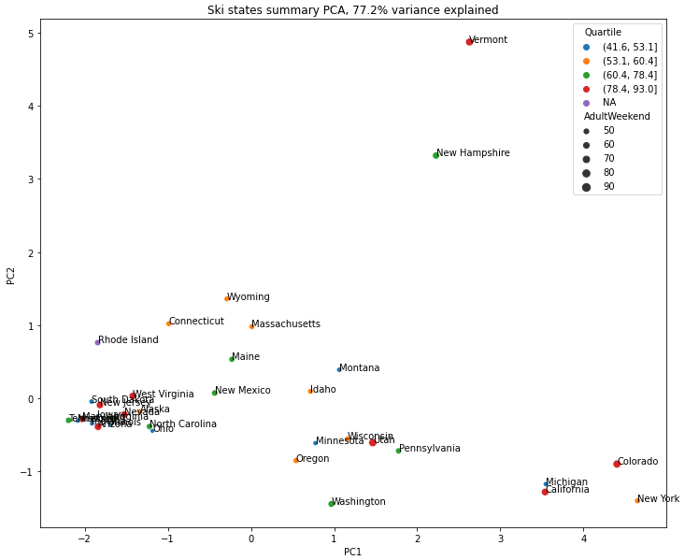
Modeling Results and Analysis
Outliers exist but no strong correlation with state and price

Slide 5
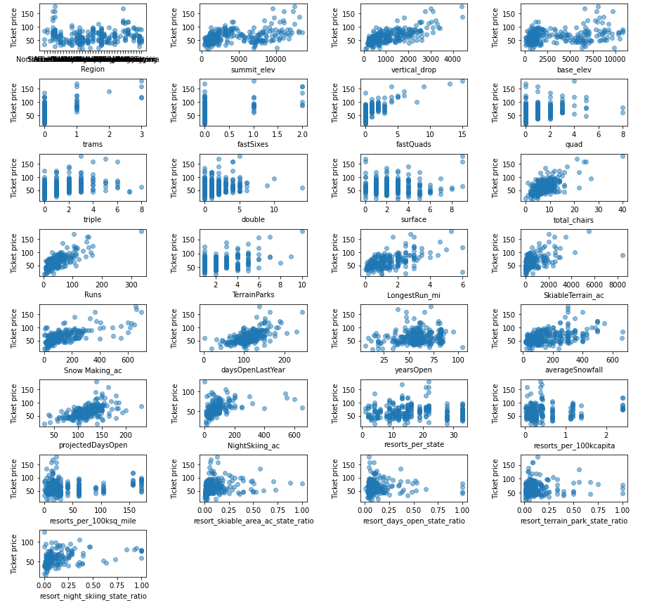
EXPLORATORY DATA ANALYSIS

Slide 6
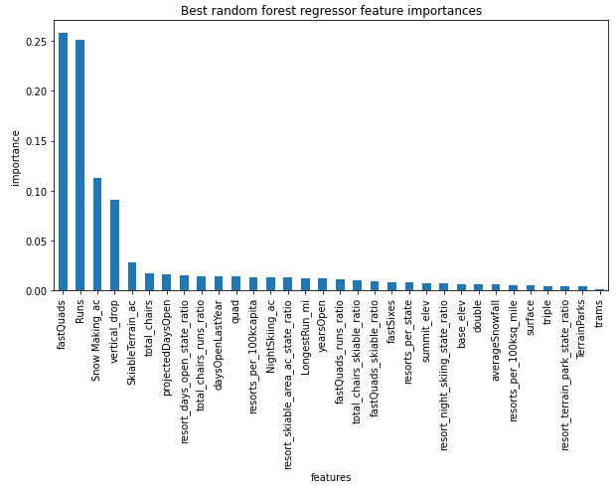
Random Forest Regressor
This is in agreement with EDA

Slide 7
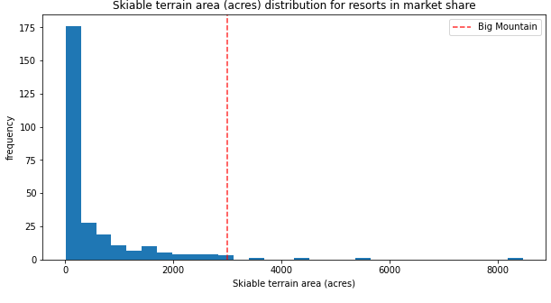
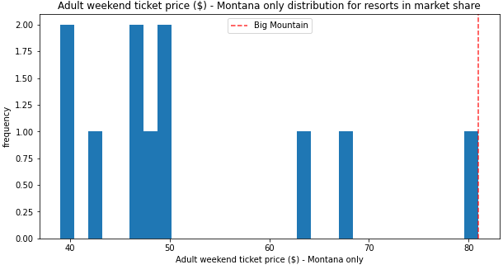
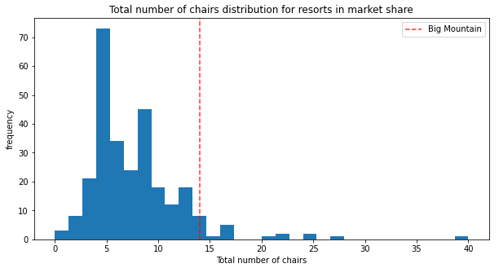
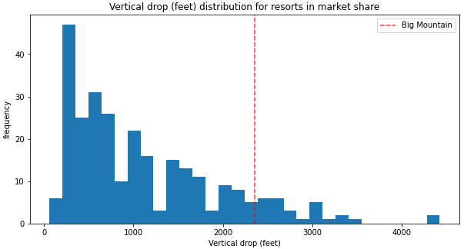
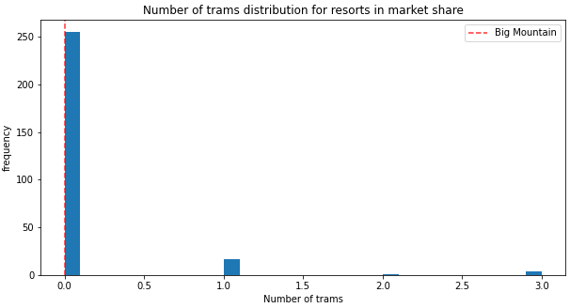
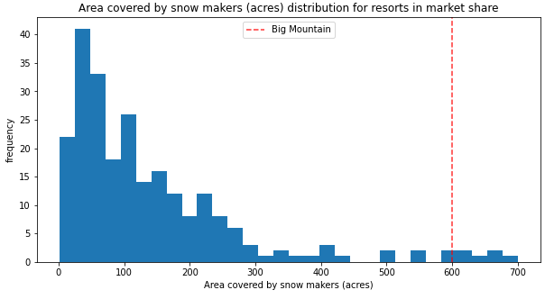
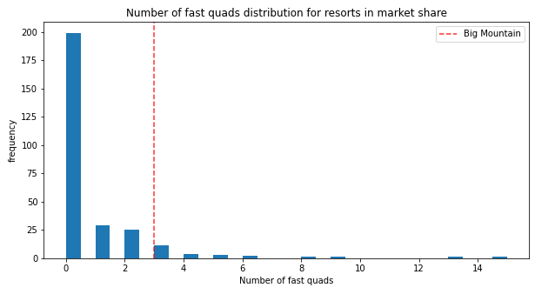
Big Mountain Offerings Relative to Resorts

Slide 8
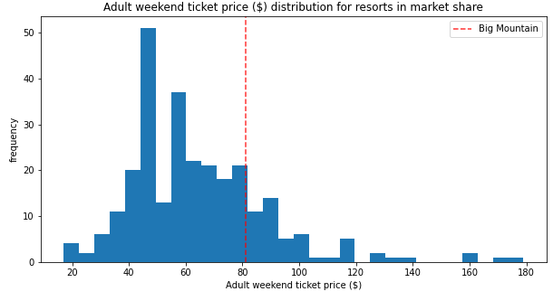
Big Mountain Relative to Resorts
Above average in most categories however this is not reflected in the price!
An increase is justifiable

Slide 9
Summary and Conclusion
Assuming 350,000 visitors for the season who each purchase 5 AdultWeekend tickets:
Model prediction price is $95.87 which is a $14.78 price increase given current conditions
Additional $1.99 ticket price increase for an additional chair

